Slide 1
Optimizing Bioinformatics workflows on Discovery Summer Bootcamp 2021
Shobana Sekar, Ph.D.
Associate Bioinformatician
6/7/2021

Slide 2
Overview
Introduction to Discovery and general terminology
Best practices for efficient resource utilization
Exercises
Exercise 1: Running an interactive job
Exercise 2: Running an array job
Exercise 3: Benchmarking
Please feel free to follow along hands-on as we go through the exercises.
Please use the terminal to access Discovery when trying the provided examples.
On a mac, open terminal and type:
$ ssh username@login.discovery.neu.edu
or open a discovery shell through Open OnDemand (demo)

Slide 3
Access the training material:
The training material is accessible on a shared directory. Copy it your $HOME or /scratch directory using the following command:
$ cp –r /work/bootcamp/Bootcamp2021_Bioinformatics ~
or
$ cp –r /work/bootcamp/Bootcamp2021_Bioinformatics /scratch/username
or using Open OnDemand (demo):
https://ood.discovery.neu.edu/

Slide 4
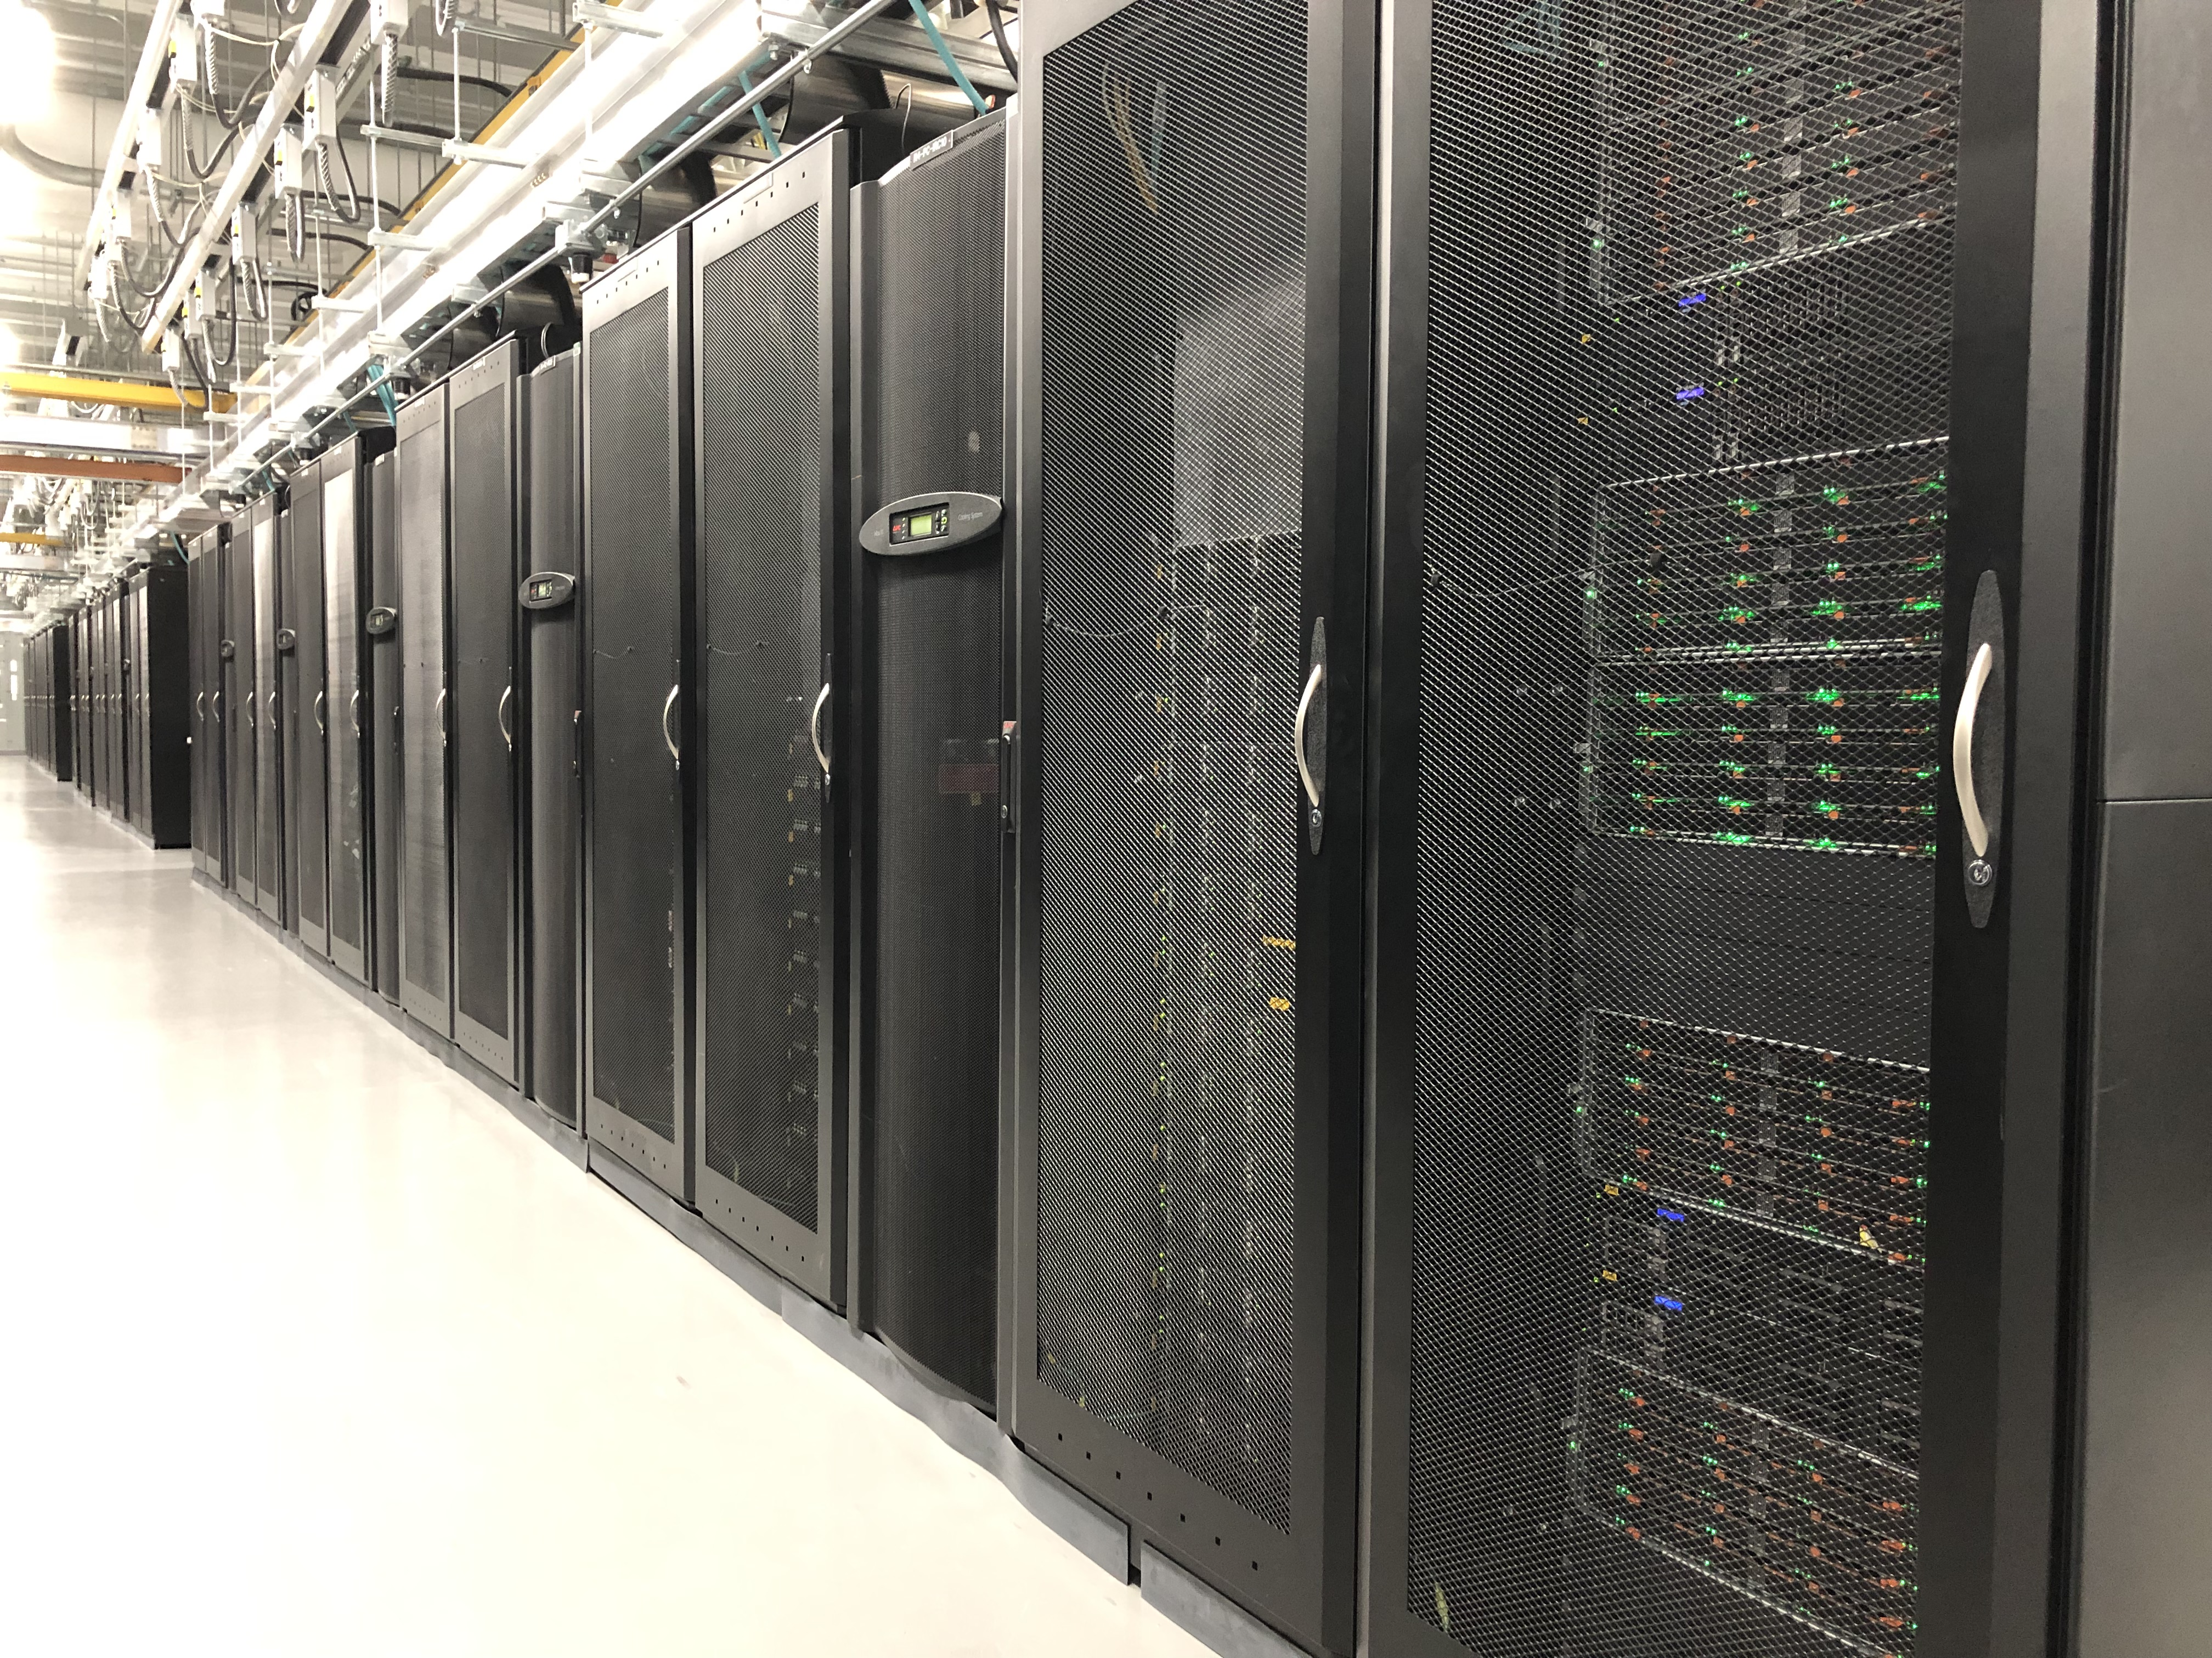
Discovery
Northeastern’s HPC cluster –located in MGHPCC (Holyoke, MA)
25,000+ CPU cores
over 200 GPUs
Connected to Northeastern’s network via 10 Gbps Ethernet (GbE)
Active, archive, secure, and cloud storage solutions
Notes:
High Performance Computing (HPC) is performing computations on a so-called supercomputer, which is usually a system that is considered at the frontline of contemporary processing capacity. The processing capacity is mainly evaluated based on the processing speed and the memory capacity. Typically, this is achieved through connecting many powerful computers together into a computer cluster via a computer network, so that the many connected computers can be used as a single machine. The HPC system relies on parallel computing technology in order to process data extremely fast.
Discovery Cluster in the MGHPCC (Holyoke, MA)
25,000+ CPU cores
over 200 GPUs
Connected to Northeastern via 10 Gbps Ethernet (GbE)
Active, archive, secure, and cloud storage solutions
Close to half of the cluster is now connected with the InfiniBand HDR 100-200Gbps high-throughput low-latency network, and we're moving towards 100% of the cluster being connected with InfiniBand. Additionally, some storage systems (/work and /scratch) also have RDMA HDR 100-200Gbps connectivity to the new nodes.

Slide 5
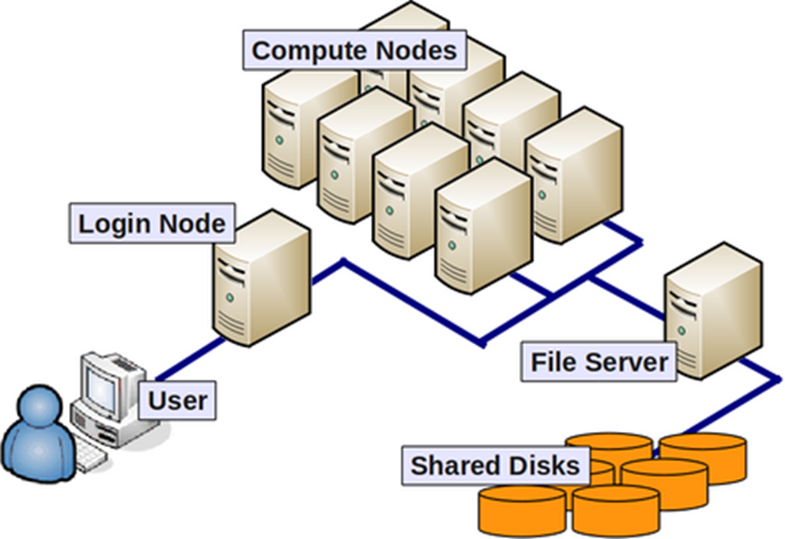
General terminology
Compute nodes: servers that perform HPC calculations.
Login nodes: servers for remote connection to the cluster - this is where you land upon logging into Discovery.
Network: connection between nodes (LAN).
Scheduler: manages HPC resources/job scheduling between users. Discovery uses the Slurm scheduler.
Image from: https://wiki.rc.hms.harvard.edu/display/O2/O2+HPC+Cluster+and+Computing+Nodes+Hardware
Notes:
Compute node / Node - a standalone computer/server/worker node in the cluster, which is running its own instance of the operating system (typically, Linux-OS like CentOS) and is interconnected with the other nodes via a network. Usually has multiple CPUs/processors/cores a separate memory, network interfaces, etc.
CPU / Socket / Processor / Core - may vary upon context and manufacturer. Initially, a CPU (Central Processing Unit) was referred to a single component within a computer. When multiple CPUs were introduced, each CPU was subdivided into multiple "cores", which were considered single processing units. Sockets are referred to as CPUs with multiple cores, though this term can depend on the vendor.
Task - A logical section of a computational workflow, typically a program or a set of instructions that is executed by a parallel unit. A parallel program consists of multiple tasks executed simultaneously.
Network - different nodes in the cluster are usually connected to each other through fast local area networks (LAN). Faster connections like InfiniBand (IB) connection provide high throughput and low latency.
Partition - (on the Discovery cluster) are groups of nodes that are grouped into logical sets.
Clock cycle - the speed unit of a CPU and corresponds to the electronic pulse of a CPU, during which the CPU performs a basic operation.

Slide 6
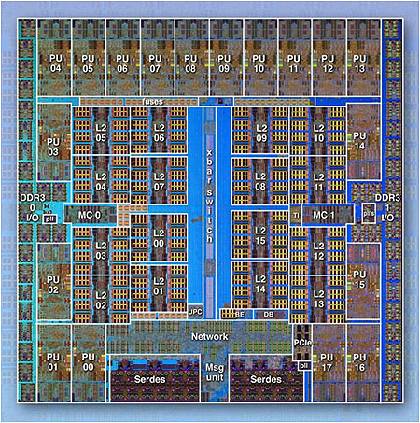
General terminology
IBM BG/Q Compute Chip with 18 cores (PU) and 16 L2 Cache units (L2)
Processor/CPU/Core: Central Processing Unit – a single processing component within a computer.
Parallel Program: consists of many tasks that can be executed in parallel.
Image from the Lawrence Livermore National Laboratory Computing: https://computing.llnl.gov/
Notes:
Compute node / Node - a standalone computer/server/worker node in the cluster, which is running its own instance of the operating system (typically, Linux-OS like CentOS) and is interconnected with the other nodes via a network. Usually has multiple CPUs/processors/cores a separate memory, network interfaces, etc.
CPU / Socket / Processor / Core - may vary upon context and manufacturer. Initially, a CPU (Central Processing Unit) was referred to a single component within a computer. When multiple CPUs were introduced, each CPU was subdivided into multiple "cores", which were considered single processing units. Sockets are referred to as CPUs with multiple cores, though this term can depend on the vendor.
Task - A logical section of a computational workflow, typically a program or a set of instructions that is executed by a parallel unit. A parallel program consists of multiple tasks executed simultaneously.
Network - different nodes in the cluster are usually connected to each other through fast local area networks (LAN). Faster connections like InfiniBand (IB) connection provide high throughput and low latency.
Partition - (on the Discovery cluster) are groups of nodes that are grouped into logical sets.
Clock cycle - the speed unit of a CPU and corresponds to the electronic pulse of a CPU, during which the CPU performs a basic operation.

Slide 7
Best practices for efficient resource utilization
General partitions such as short, express, debug etc. are shared across all users, so take advantage of your lab’s partition if you have one, which is exclusive to your lab members.
For doing this, add the following while submitting jobs
or
#SBATCH -p <PI-partition-name>
$ srun --partition=<PI-partition-name> --nodes 1 --cpus-per-task 2 --mem=1G --time=01:00:00 --pty /bin/bash
For further details, please check https://rc-docs.northeastern.edu/en/latest/hardware/partitions.html or email rchelp@northeastern.edu

Slide 8
Best practices for efficient resource utilization
2. Perform benchmarking i.e., run a few test jobs to assess resource utilization after they complete. Use the ‘seff <jobid>’ command for this on your test jobs
Job ID: 18224522
Cluster: discovery
User/Group: s.sekar/users
State: COMPLETED (exit code 0)
Nodes: 1
Cores per node: 64
CPU Utilized: 22-04:58:07
CPU Efficiency: 90.82% of 24-10:51:44 core-walltime
Job Wall-clock time: 09:10:11
Memory Utilized: 86.83 GB
Memory Efficiency: 17.37% of 500.00 GB
$ seff 18224522
Notes:
Performance tests may also include calculations of speedup, efficiency and scalability over multiple jobs (HPC training material). Note that the CPU efficiency provided from "seff" (time of CPU being utilized vs. idle) is different from efficiency calculations from speedup tests (defined as the ratio of speedup by the number of cores).

Slide 9
Best practices for efficient resource utilization
3. When submitting jobs, you can specify specific hardware features required using the --constraint= flag. You can list out the available features and their corresponding information as below:
However, remember that using a constraint can mean that you may wait longer for your job to start, as the scheduler will need to find and allocate the appropriate hardware that you have specified for your job.
source: https://rc-docs.northeastern.edu/en/latest/hardware/hardware_overview.html#hardware-overview
$ sinfo -p short --Format=nodes,cpus,memory,nodeai,features
NODES | CPUS | MEMORY | NODES(A/I) | AVAIL_FEATURES
175 | 24 | 109000+ | 144/9 | lenovo,rapl,haswell
429 | 28 | 256000+ | 317/41 | broadwell
20 | 128 | 512000 | 19/0 | zen2,ib
4 | 16 | 384000 | 4/0 | sandybridge,largemem
1 | 20 | 128000 | 1/0 | ivybridge
128 | 56 | 186000 | 116/1 | ib,cascadelake
2 | 224 | 3094534 | 2/0 | cascadelake,ib
Specify one of this in the --constraint option

Slide 10
Best practices for efficient resource utilization
4. Parallelize using the following strategies:
Use threads to parallelize your job, if and when supported by the program you are running. The number of threads specified should be the same as the number of cores requested.
e.g., bwa aligner supports threads using -t parameter
This method parallelizes instructions on the same data
#!/bin/bash
#SBATCH --nodes=1
#SBATCH --cpus-per-task=8
#SBATCH --time=4:00:00
#SBATCH --job-name=BWA-MEM
#SBATCH --mem=100G
#SBATCH --partition=lotterhos
bwa mem -t 8 reference.fa read1.fq > aligned.sam

Slide 11
Best practices for efficient resource utilization
Splitting the jobs across chromosomes or samples if applicable.
This method parallelizes/splits data, running the same instruction on each chunk of the data.
Note: Unless your tool is configured to support MPI (Message Passing Interface),
always specify nodes = 1. If using a number higher than 1, the program should be
configured to communicate between nodes, if not the additional nodes may just remain idle.
#!/bin/bash
#SBATCH --nodes=1
#SBATCH --cpus-per-task=8
#SBATCH --time=4:00:00
#SBATCH --job-name=Freebayes
#SBATCH --mem=100G
#SBATCH --partition=lotterhos
freebayes -f ref.fa -r chr1 aln.bam > var.vcf

Slide 12
Best practices for efficient resource utilization
5. Whenever possible, try to run individual tasks in a pipeline separately – this acts as a ‘checkpointing’ technique, i.e., you do not need to re-run the entire pipeline when one step fails, but re-run only the step that failed.
e.g., a typical WGS analysis workflow includes the following steps:
FASTQC > Alignment > Mark duplicates > Filtering > Merging > Variant Calling
Performing one step at a time helps you troubleshoot errors in specific steps in a more efficient manner
Once you have verified all pipeline steps work well individually, you can also employ automation methods by using job arrays/job dependency techniques.

Slide 13
Exercises

Slide 14
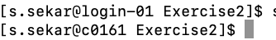
Exercise 1
Running an interactive job
In this exercise, we will use the slurm command srun to allocate an interactive job. We will be running the FASTQC program on a sample fastq file.
Change directory to the Exercise1 folder before you begin:
Step 1: Request resources for your interactive job:
$ cd /home/<username>/Exercise1
$ srun --partition=reservation --reservation=bootcamp2021cpu --nodes 1 --cpus-per-task 1 --mem=1G --time=00:10:00 --pty /bin/bash
You will see your prompt change as below, indicating that you are now on a compute node:

Slide 15
Exercise 1
Step 2: Load the required modules to run FASTQC on a sample fastq:
Step 3: Run the fastqc command on the input fastq:
$ module load oracle_java/jdk1.8.0_181
$ module load fastqc
$ fastqc wgEncodeUwRepliSeq_1.fastq
You will see the progress of your job on the screen. The output files will be saved in the same directory, with a “.zip” and “.html” extension to your sample name.

Slide 16
Exercise 1
To view the results, go to https://ood.discovery.neu.edu/ and login using your NEU credentials.
Go to
Files -> Home Directory -> /path/to/Exercise1/ ->
Click on wgEncodeUwRepliSeq_1_fastqc.html ->
View

Slide 17
Exercise 2
Running an array job
In this exercise, we will submit the FASTQC jobs on multiple samples using the concept of array jobs.
Change directory to the Exercise2 folder before you begin:
Step 1: Open and inspect the script fastqc_arrayjob.slurm.sh
$ cd /home/<username>/Exercise2
$ vi fastqc_arrayjob.slurm.sh

Slide 18
Exercise 2
Step 2: Submit the fastqc array job script to the queue
You will notice 3 jobs being kicked off at the same time, one for each sample.
This is an efficient way to execute the same job on multiple samples at the same time.
$ sbatch fastqc_arrayjob.slurm.sh

Slide 19
Exercise 3
Benchmarking samtools-merge
In this exercise, we will benchmark the merge functionality of samtools with different number of CPUs setting each time.
We will perform the merge operation on 3 sample BAM files from the 1000 genomes project.
Change directory to the Exercise3 folder before you begin:
$ cd /home/<username>/Exercise3

Slide 20
Exercise 3
Step 1: Open the 4 different job scripts and note the difference in number of CPUs requested in each
Step 2: Submit the samtools merge job scripts to the queue one by one
$ vi samtools-merge_n2.sh
$ vi samtools-merge_n4.sh
$ vi samtools-merge_n8.sh
$ vi samtools-merge_n16.sh
$ sbatch samtools-merge_n2.sh
$ sbatch samtools-merge_n4.sh
$ sbatch samtools-merge_n8.sh
$ sbatch samtools-merge_n16.sh

Slide 21
Exercise 3
Once your jobs complete, run the ‘seff <job id>’ command to assess resource utilization in each run. Here is the output of ‘seff’ from this example:
Job ID: 19372206
Cluster: discovery
User/Group: s.sekar/users
State: COMPLETED (exit code 0)
Nodes: 1
Cores per node: 2
CPU Utilized: 00:12:07
CPU Efficiency: 94.66% of 00:12:48 core-walltime
Job Wall-clock time: 00:06:24
Memory Utilized: 3.98 MB
Memory Efficiency: 0.39% of 1.00 GB
Job ID: 19372416
Cluster: discovery
User/Group: s.sekar/users
State: COMPLETED (exit code 0)
Nodes: 1
Cores per node: 4
CPU Utilized: 00:12:53
CPU Efficiency: 88.24% of 00:14:36 core-walltime
Job Wall-clock time: 00:03:39
Memory Utilized: 5.26 MB
Memory Efficiency: 0.51% of 1.00 GB
Job ID: 19372417
Cluster: discovery
User/Group: s.sekar/users
State: COMPLETED (exit code 0)
Nodes: 1
Cores per node: 8
CPU Utilized: 00:13:26
CPU Efficiency: 72.48% of 00:18:32 core-walltime
Job Wall-clock time: 00:02:19
Memory Utilized: 7.78 MB
Memory Efficiency: 0.76% of 1.00 GB
Job ID: 19372418
Cluster: discovery
User/Group: s.sekar/users
State: COMPLETED (exit code 0)
Nodes: 1
Cores per node: 16
CPU Utilized: 00:13:23
CPU Efficiency: 46.04% of 00:29:04 core-walltime
Job Wall-clock time: 00:01:49
Memory Utilized: 11.52 MB
Memory Efficiency: 1.13% of 1.00 GB

Slide 22
Thank you

